Slide 1

WEEK 2
Network Traffic Analysis, Nmap & Windows Logging
Intern: Rashmi Bishen
Organisation: DG Interns Hub
Date: 30 October 2026

Slide 2
Week 2: Objectives
Understand TCP connection setup, data transfer and teardown.
Recognise normal and suspicious patterns in common network protocols.
Use Wireshark capture and display filters to isolate relevant traffic.
Compare Nmap scan types and understand their network footprint.
Interpret Windows Security events and logon types.
Build a baseline mindset for SOC investigations.

Slide 3
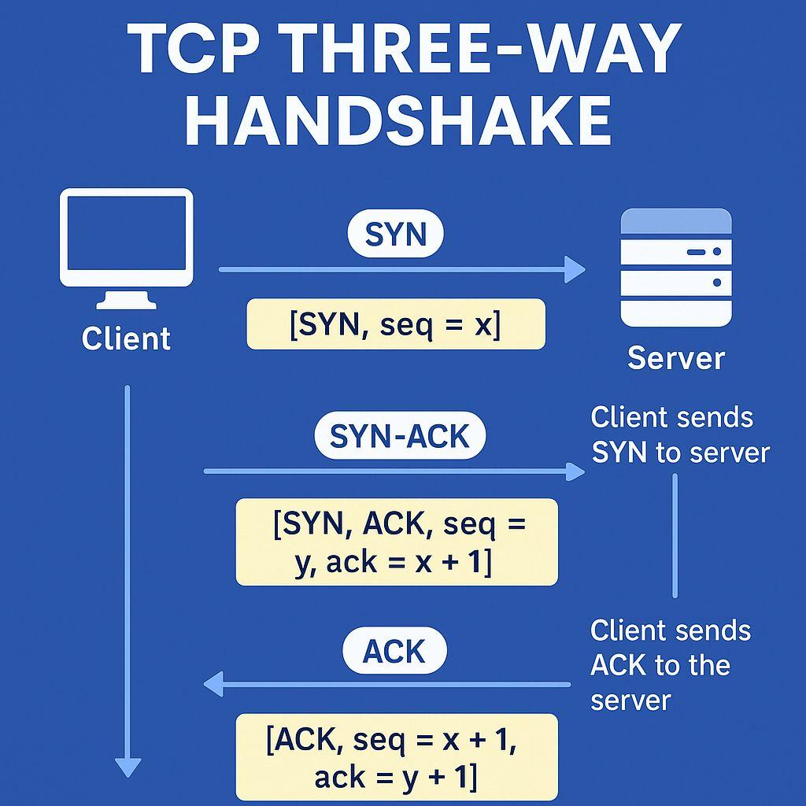
TCP: Handshake, Flags and Teardown
Handshake: SYN → SYN-ACK → ACK establishes a TCP session.
Graceful close: FIN/ACK exchanges close each direction.
RST terminates a connection abruptly.
SYN bursts without completed handshakes can be a scan indicator.
ACK, PSH and URG must be interpreted in connection context.

Slide 4
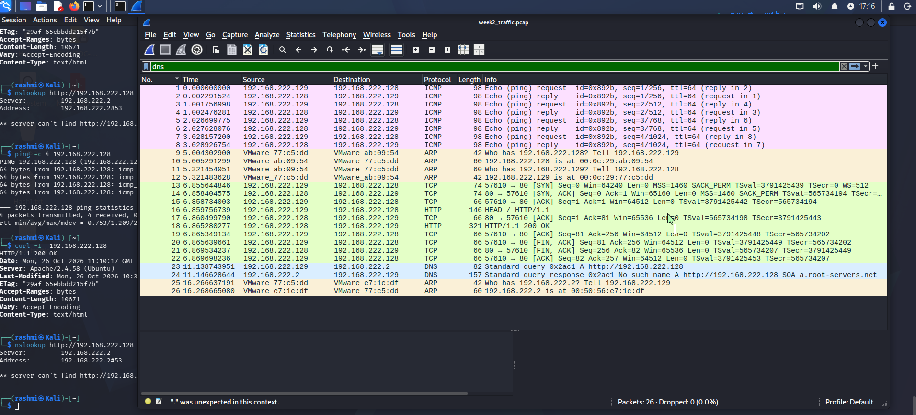
Protocol Traffic: What to Look For
DNS: query volume, unusual domains, repeated NXDOMAIN and unexpected resolvers.
HTTP: methods, host, URI, status codes, user-agent and clear-text sensitive data.
HTTPS/TLS: handshake metadata, certificate validity, SNI and protocol/cipher anomalies.
ARP: unexpected IP-to-MAC changes or conflicting ARP replies.
ICMP: echo patterns, sweeps, unusual volume
and error messages.
SMB: expected internal sharing versus unusual
access, authentication failures or lateral movement.
DG Interns Hub | Week 2 04

Slide 5
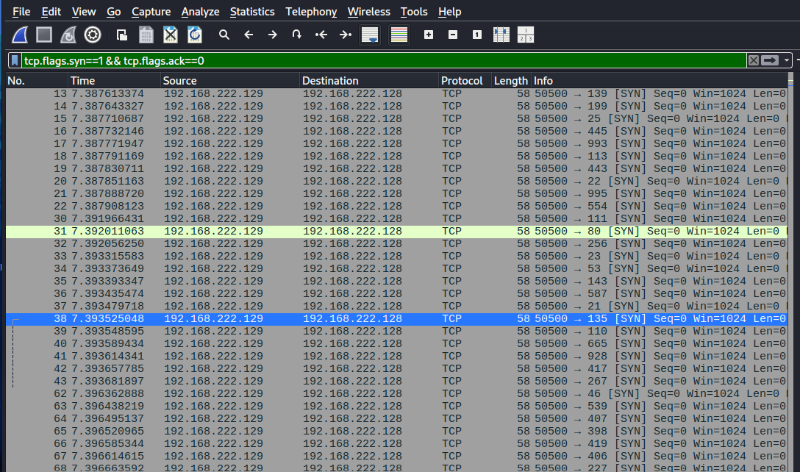
Wireshark: Capture vs Display Filters
Capture filters (BPF) restrict what is saved; excluded packets are not in the capture.
Display filters narrow the visible packet list without deleting captured packets.
Examples: dns | http.request | tls.handshake
Scan view: tcp.flags.syn==1 && tcp.flags.ack==0

Slide 6
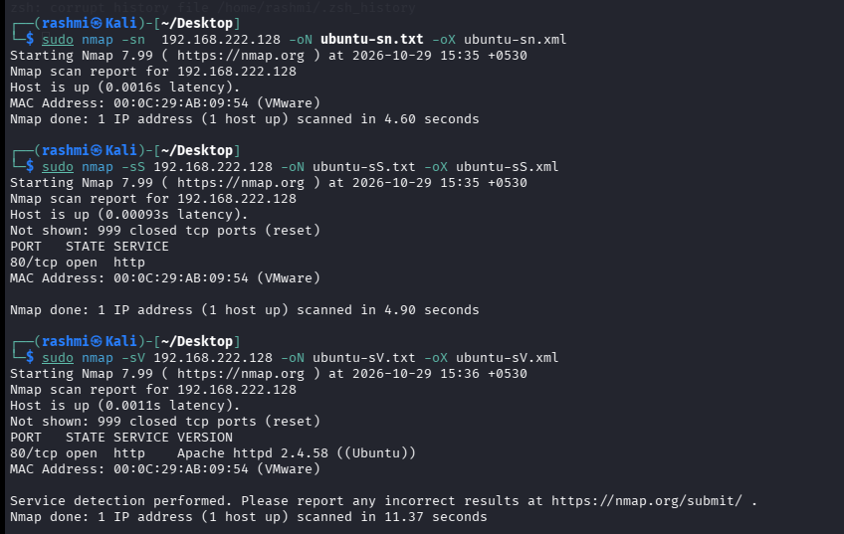
Nmap: Scan Types and Network Footprint
-sn: host discovery only; ARP/ICMP/TCP/UDP probes may be visible.
-sS: half-open SYN scan; SYN followed by SYN-ACK or RST responses.
-sT: full TCP connect; completes handshake and is more likely to reach service logs.
-sU: UDP probes; may produce UDP replies or ICMP port-unreachable messages.
-sV / -O / -A: service probes, OS fingerprinting and broader combined probing.

Slide 7
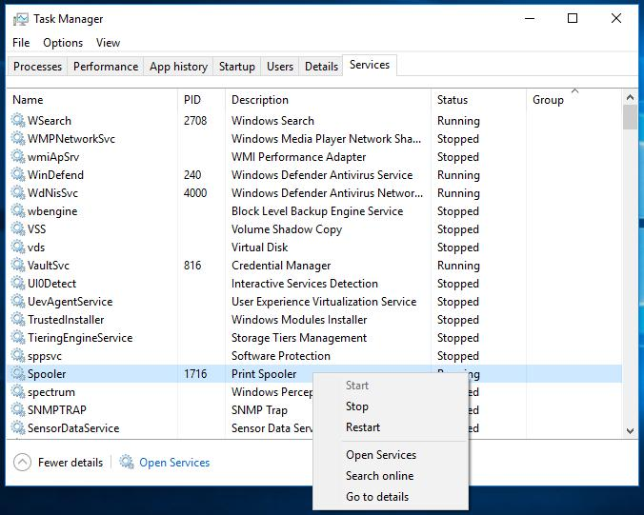
Windows Fundamentals
Processes are running program instances identified by process IDs.
Services are background components managed by the Service Control Manager.
Registry stores hierarchical system, user and application configuration.
Users and groups define identities and permission assignments.
UAC introduces an elevation boundary for administrative actions.
Event Viewer: Application, Security and System logs provide different viewpoints.

Slide 8
Key Windows Security Events
Windows Logon Types
4624 / 4625: successful / failed logon.
4634 / 4648 / 4672: logoff / explicit credentials / special privileges.
4688 / 4697: process creation / service installation.
4720 / 4722 / 4724: account creation / account enablement / password reset attempt.
4732: member added to a local security-enabled group.
4768 / 4769 / 4776: Kerberos TGT / service ticket / NTLM credential validation.
1102: Security audit log cleared; investigate promptly.
2 Interactive: local console sign-in.
3 Network: access to a network resource.
4 Batch: scheduled/batch activity.
5 Service: service account logon.
7 Unlock: unlock an existing session.
10 RemoteInteractive: Remote Desktop session.
11 CachedInteractive: cached domain credentials used while offline.
Always compare account, source, time, host and expected role.

Slide 9
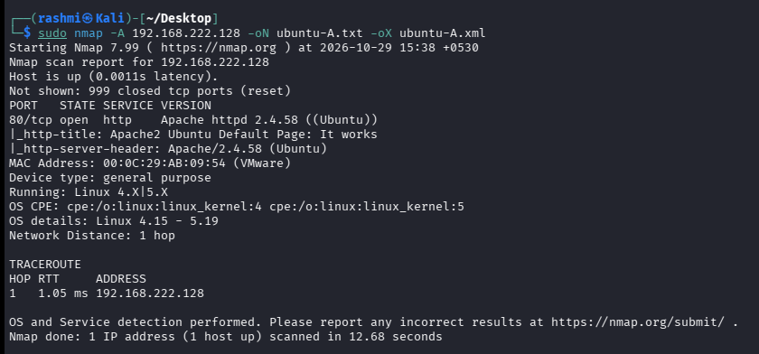
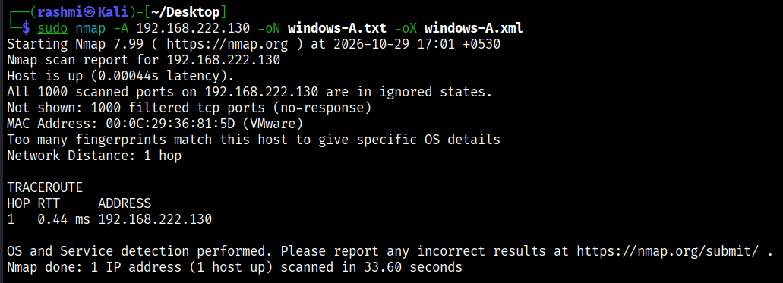
Hands-on: Traffic Capture and Nmap
Ubuntu VM: Apache installed as the HTTP target.
Kali VM: ping, curl and nslookup generated ICMP, HTTP
and DNS traffic.
Wireshark: captured handshake, HTTP GET, DNS query and
ICMP echo; PCAP saved.
Nmap: -sn, -sS, -sV, -O and -A run against authorised Ubuntu and Windows VMs.
Outputs saved in normal and XML
formats; SYN scan captured with the
SYN-only display filter.

Slide 10
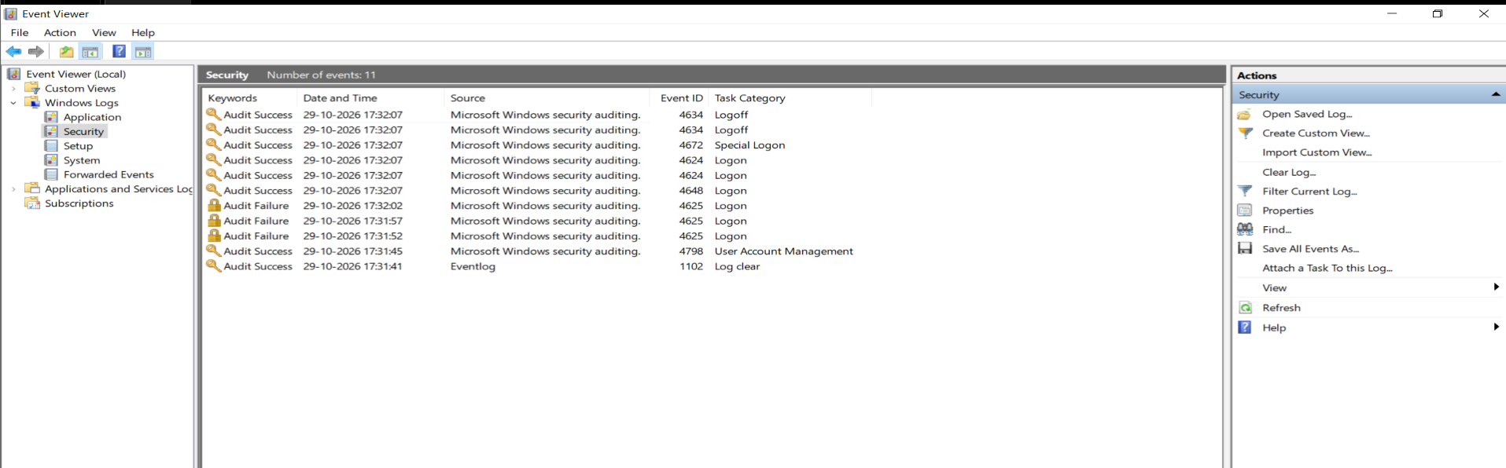
Evidence, Findings and Baseline
Evidence set: PCAP, Wireshark screenshots, Nmap -oN/-oX outputs and Event Viewer screenshots.
PowerShell CSV supports account-level failed-logon review.
Baseline = documented normal behaviour for users, hosts, services and network traffic.
Baseline context helps reduce false positives and prioritise meaningful deviations.
Insert actual screenshots and measured findings from the Findings/Captures folders.

Slide 11
Conclusion and Week 3 Readiness
Week 2 connected packet-level observations with Windows host-level telemetry.
A SYN burst is a useful network indicator; Windows events add account and endpoint context.
Week 3 can build on this foundation with endpoint monitoring and IDS/Snort detection.
Next step: correlate network alerts with logon, process, service and group-change events.
Thank you.

